Slide 1
Generating Realistic Houses Using GANs
Alexandre Boyer - 7720512
Mohamed Asni - 7340184

Slide 2
What is our problem/task?
Use generative adversarial neural network (GAN) in order to generate a model that is able to generate realistic houses with realistic features.

Slide 3
Process
Remove features from the csv file that we deemed unnecessary or corrupt data.
Develop an autoencoder that would compress the house data and decompress it.
We developed an encoder and decoder. The decoder will be used later as our generator in our GAN.
We need the autoencoder to extract the data’s latent space.
Also normalized our data which will then be used as inputs later.
Design our GAN model.
Develop our GAN.
Develop our discriminator based on a dense neural network (DNN).
Develop our generator based on our decoder that was previously developed during the autoencoder phase.
Train our model.
First perform pre-training on the discriminator for 10 epochs.
Then train both the discriminator and generator at the same time for 100 epochs.
Save our trained model.

Slide 4
MNIST GAN
This was our stepping stone to learning how GANs work and how to properly implement and train them.
Tested different optimization techniques.
We didn’t use Keras, this slowed down the process significantly.

Slide 5
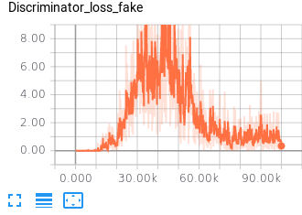
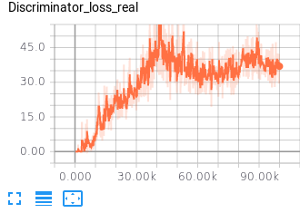
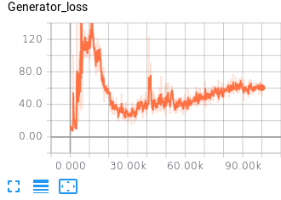
MNIST GAN Results
Before:
After:

Slide 6
House GAN V1.0
Results were not as good as we expected them to be.
Had trouble separating the generator and discriminator which led to them working together instead of against each other.

Slide 7
House GAN V2.0
Used keras_adversarial framework. Comes with the GAN specific training and compile method.
Made the previously built decoder obsolete.
Training is very fast even on consumer grade GPU.

Slide 8
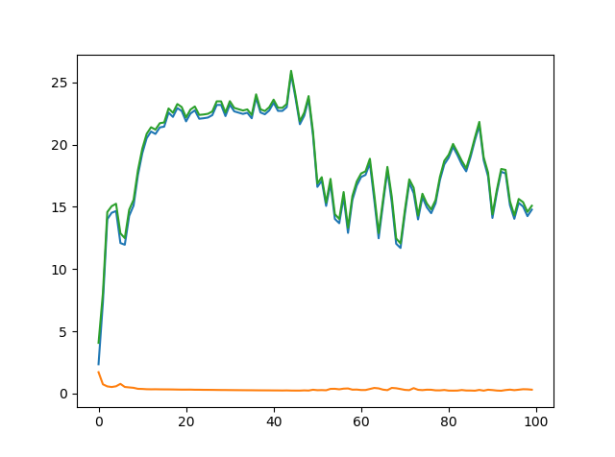
GAN Houses V1

Slide 9
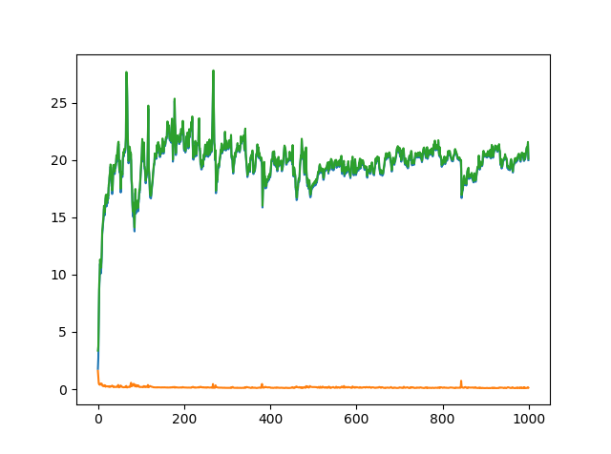
GAN Houses V2

Slide 10
Optimizations
Added more layers and more neurons.
Pre-trained the discriminator.
Used Batch normalization layer and Dropout layer.
Normalized our inputs.

Slide 11
Improvements
Much larger dataset.
A thorough normalization of the input data.
Proper research on size and architecture of network.

Slide 12
Thank you!
Code available on Github: https://github.com/mohamedasni/GAN_houses

